Slide 1
Azure Automation DSC
Pull-server (and more) as a Service
Aleksandar Nikolić & Ben Gelens

Slide 2
Get-MyInfo
Name : Aleksandar Nikolić
Job : Trainer
MVP : {CDM (PowerShell), Microsoft Azure}
Company : {PowerShell Magazine, M.O.3.A.K. IT Consulting}
Email : aleksandar@powershell.com
Twitter : @alexandair
Community : powershell.com
Blogging : PowerShellMagazine.com
Name : Ben Gelens
Job : Consultant
MVP : CDM (PowerShell)
Company : inovativ
Email : ben@bgelens.nl
Twitter : @bgelens
Community : {Hyper-V.nu, azurestack.eu, DuPSUG}
Blogging : {Hyper-V.nu, PowerShellMagazine.com, azurestack.eu}

Slide 3
Agenda
What is Azure Automation DSC?
Onboarding machines for management
Lots of AA DSC demos!
Notes:
Assume everyone knows basic DSC concepts (e.g. Push and Pull model, resources, MOF compile, etc.)

Slide 4
What is Azure Automation DSC?
Part of the Azure Automation service
PowerShell DSC pull/reporting service hosted in the cloud
Manage physical hosts and VMs (Windows or Linux) in any cloud or on-premises

Slide 5
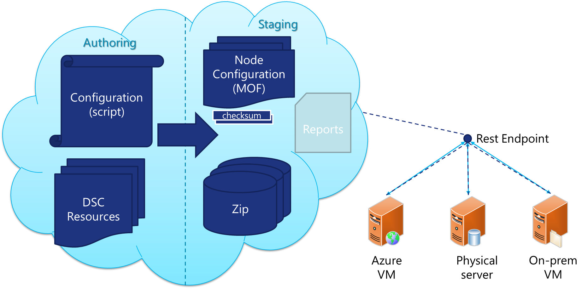

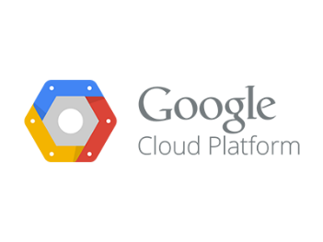



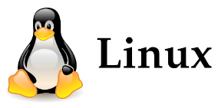
Azure Automation DSC
Notes:
Azure Automation DSC is a Pull Server as a Service solution.
You create an Azure Automation account which, as you might know, enables you to run PowerShell Workflow, native PowerShell and Graphical Workflow Runbooks.
These Runbooks can be scheduled and make use of shared assets like PowerShell modules and stored Credentials.
Recently DSC is added as a new service to the Automation Account offering.
Azure Automation DSC is a highly available and secure DSC Pull Server as a Service hosted in Azure. Which means:
you don’t have to deal with setting up a Pull Server and reporting infrastructure anymore
You don’t have to deal with certificates. This is all handled for you
placing MOF files
generating checksums
Etc
It’s all made easy ☺ And we are just a couple of minutes away from showing you just how easy this is.
AA DSC is build on top of what the Automation Account already had existing and therefore can leverage the shared assets and modules just as with the Runbooks.
DSC resource modules can be imported and Nodes which are onboarded can download them directly.
AA DSC’s offering is not limited to Azure VMs. It hosts a public and secure REST endpoint which is available for any internet capable node.
It could be running in Azure, Amazon, Google Cloud, Azure Stack, or just be a physical machine. It doesn’t matter as long as they are running WMF5 RTM or the Linux DSC1.1 packages.

Slide 6

Azure Automation DSC Terms
DSC Configuration: Allows you to define, using PowerShell syntax, the desired state of your environment
DSC Node Configuration: Same as a “MOF” or “configuration document”
DSC Node: Any machine that has its configuration managed by DSC
DSC Resource: Building blocks that you can use to define a DSC configuration
Compilation Job: Causes DSC items to be placed on the Azure Automation DSC pull server

Slide 7
Demo
Automation Account
Notes:
Setting up the AA Account. Telling about REST endpoint and authorization keys (UI).

Slide 8
Different Ways to Onboard Nodes
How to onboard | What to onboard
Register-AzureRMAutomationDscNode | VM v2
Set-AzureRmVMDscExtension | VM v2
Set-AzureVMDscExtension | VM v1 (classic)
Set-AzureRmVMExtension (Linux as well) | VM v2
Set-AzureVMExtension | VM v1 (classic)
Get-AzureRmAutomationDscOnboardingMetaconfig (Linux as well) | VM v1 (classic), VM v2, on-premises VM/physical, and VMs in other clouds (e.g. AWS)
ARM template (Linux as well) | VM v2
Azure Portal (“Add Azure VM”) | VM v2
Azure Portal (Azure Automation DSC Extension) | VM v1 (classic)
Notes:
Azure Linux VMs are not supported for in-portal onboarding, though they may appear in the list below. Azure Classic VMs will not appear in the list below but can be onboarded using the Azure Classic VMs experience, via All settings -> Extensions -> Add -> Azure Automation DSC.
Azure Automation DSC brings the same management layer to PowerShell Desired State Configuration as Azure Automation offers for PowerShell Workflows today.
Azure Automation DSC allows you to author and manage PowerShell Desired State Configurations, import DSC Resources, and generate DSC Node Configurations (MOF documents), all in the cloud. These DSC items will be placed on the Azure Automation DSC pull server so that target nodes in the cloud or on-premises can pick them up, automatically conform to the desired state they specify, and report back on their compliance with the desired state to Azure Automation.
Adding the Azure Automation DSC extension to your Azure VM will automatically onboard the VM for configuration management using Azure Automation DSC.

Slide 9
Demo
Onboarding Nodes
Notes:
Onboarding a Linux node. Use DSCForLinux extension (Azure Stack)
Manual onboarding using downloaded meta.mof / self-generated meta.mof (Local Hyper-V, Win2012R2 WMF5 RTM)

Slide 10
Demo
Configuring Hybrid Worker Server

Slide 11
Summary
AA DSC makes hybrid heterogeneous configuration management a breeze!
Want to learn more:
https://channel9.msdn.com/Niners/bgelens

Slide 12
Next Steps...
Now: 15 min break
Grab a coffee
Stay here to enjoy next presentation
Change track and switch to another room
Ask me questions or meet me in a breakout session room afterwards

Slide 13
Questions?

